Slide 1

Blazor Aand MAUI

Slide 2
Agenda
Blazor Web App
Introduction
Render Mode
PreRender
.Net MAUI Blazor hybrid and web app
Introduction
Thinking about StarterkitOnWeb

Slide 3
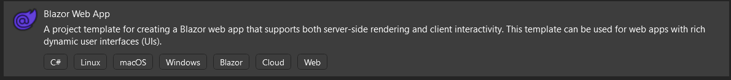
Blazor Web App
Introduction
Blazor Web is a full-stack web UI framework that render content at either the component or page level with:
Static server rendering to generate static HTML.
Interactive Server rendering.
Interactive WebAssembly rendering.
Interactive Auto (automatic) rendering.
https://learn.microsoft.com/en-us/aspnet/core/release-notes/aspnetcore-8.0?view=aspnetcore-8.0#full-stack-web-ui

Slide 4
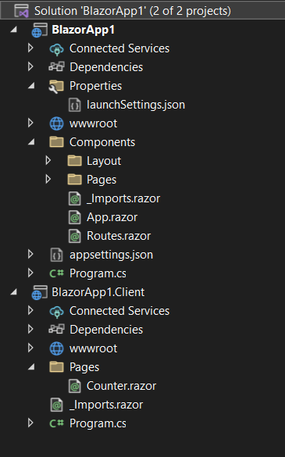
Blazor Web App
Introduction
The components in the server is in the solution's project Components/Pages folder.
The components in the client is in the solution's project Pages folder with a name that ends in .Client.
// Add services to the container.
// Add services to support rendering Interactive Server and WebAssembly components.
builder.Services.AddRazorComponents()
.AddInteractiveServerComponents()
.AddInteractiveWebAssemblyComponents();
//......
app.MapRazorComponents<App>()
.AddInteractiveServerRenderMode()
.AddInteractiveWebAssemblyRenderMode()
.AddAdditionalAssemblies(typeof(Counter).Assembly);

Slide 5
Blazor Web App
Render Mode
Name | Description | Render location | Interactive
Static | Static server rendering | Server | ❌
Interactive Server | Interactive server rendering using Interactive Server | Server | ✔️
Interactive WebAssembly | Interactive client rendering using Interactive WebAssembly | Client | ✔️
Interactive Auto | When websockt connected using Interactive Server, otherwise Interactive WebAssembly | Server/Client | ✔️
https://learn.microsoft.com/en-us/aspnet/core/blazor/components/render-modes?view=aspnetcore-8.0#render-modes

Slide 6
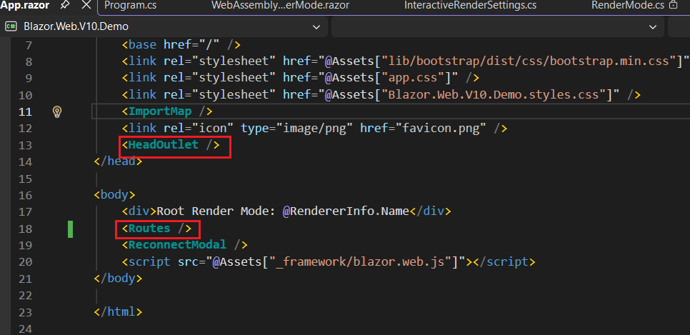
Blazor Web App
App.razor set root compoment as static render mode by default,which compatible all interactive rendermode in child compoment

Slide 7
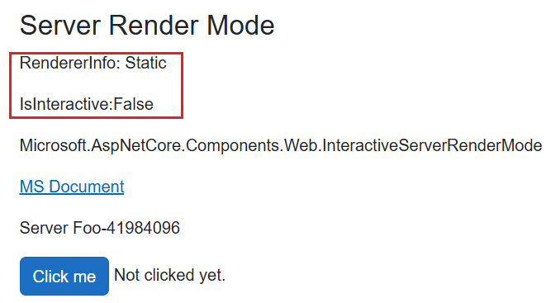
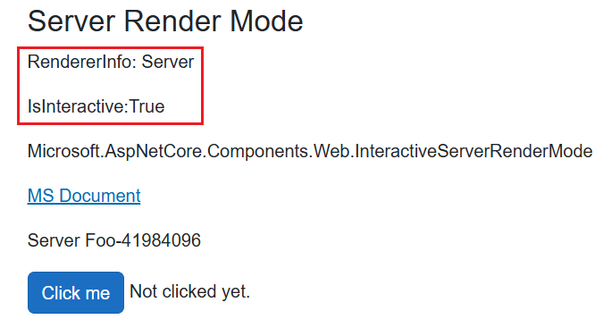
Blazor Web App
Prerender
SSR(Server-Side Rendering) prerender a static html page at server side until interactive established.Can use RendererInfo.Name and RendererInfo.IsInteractive to shown current renderer and interactive status
prerender static html page
interactive established

Slide 8
Blazor Web App
Prerender
Prerender can disable prerender as follow：
public static class CustomerRenderMode
{
public static IComponentRenderMode InteractiveServerWithoutPrerender { get; } = new InteractiveServerRenderMode(prerender: false);
public static IComponentRenderMode InteractiveAutoWithoutPrerender { get; } = new InteractiveAutoRenderMode(prerender: false);
public static IComponentRenderMode InteractiveWebAssemblyWithoutPrerender { get; } = new InteractiveWebAssemblyRenderMode(prerender: false);
}
@page "/render-mode-server-no-prerender"
@rendermode CustomerRenderMode.InteractiveServerWithoutPrerender
……

Slide 9
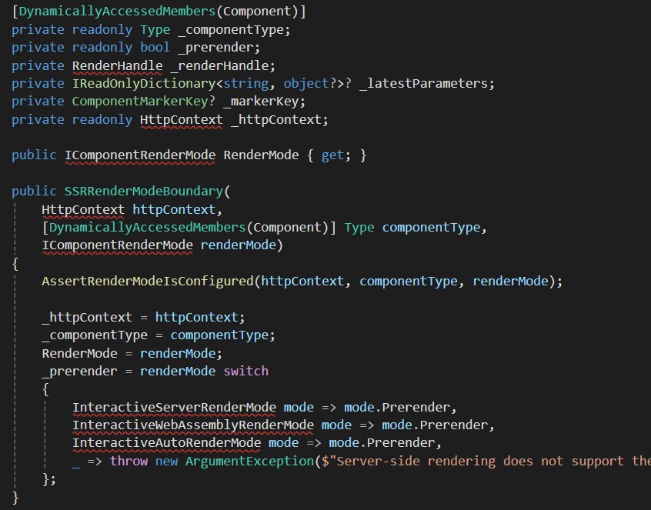
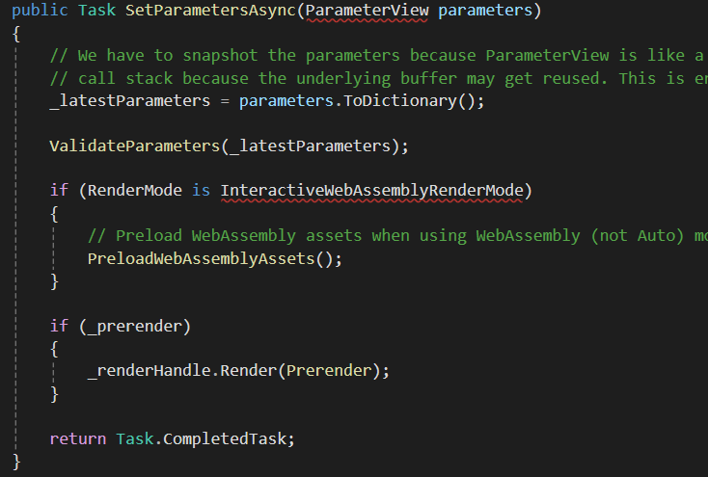

Slide 10
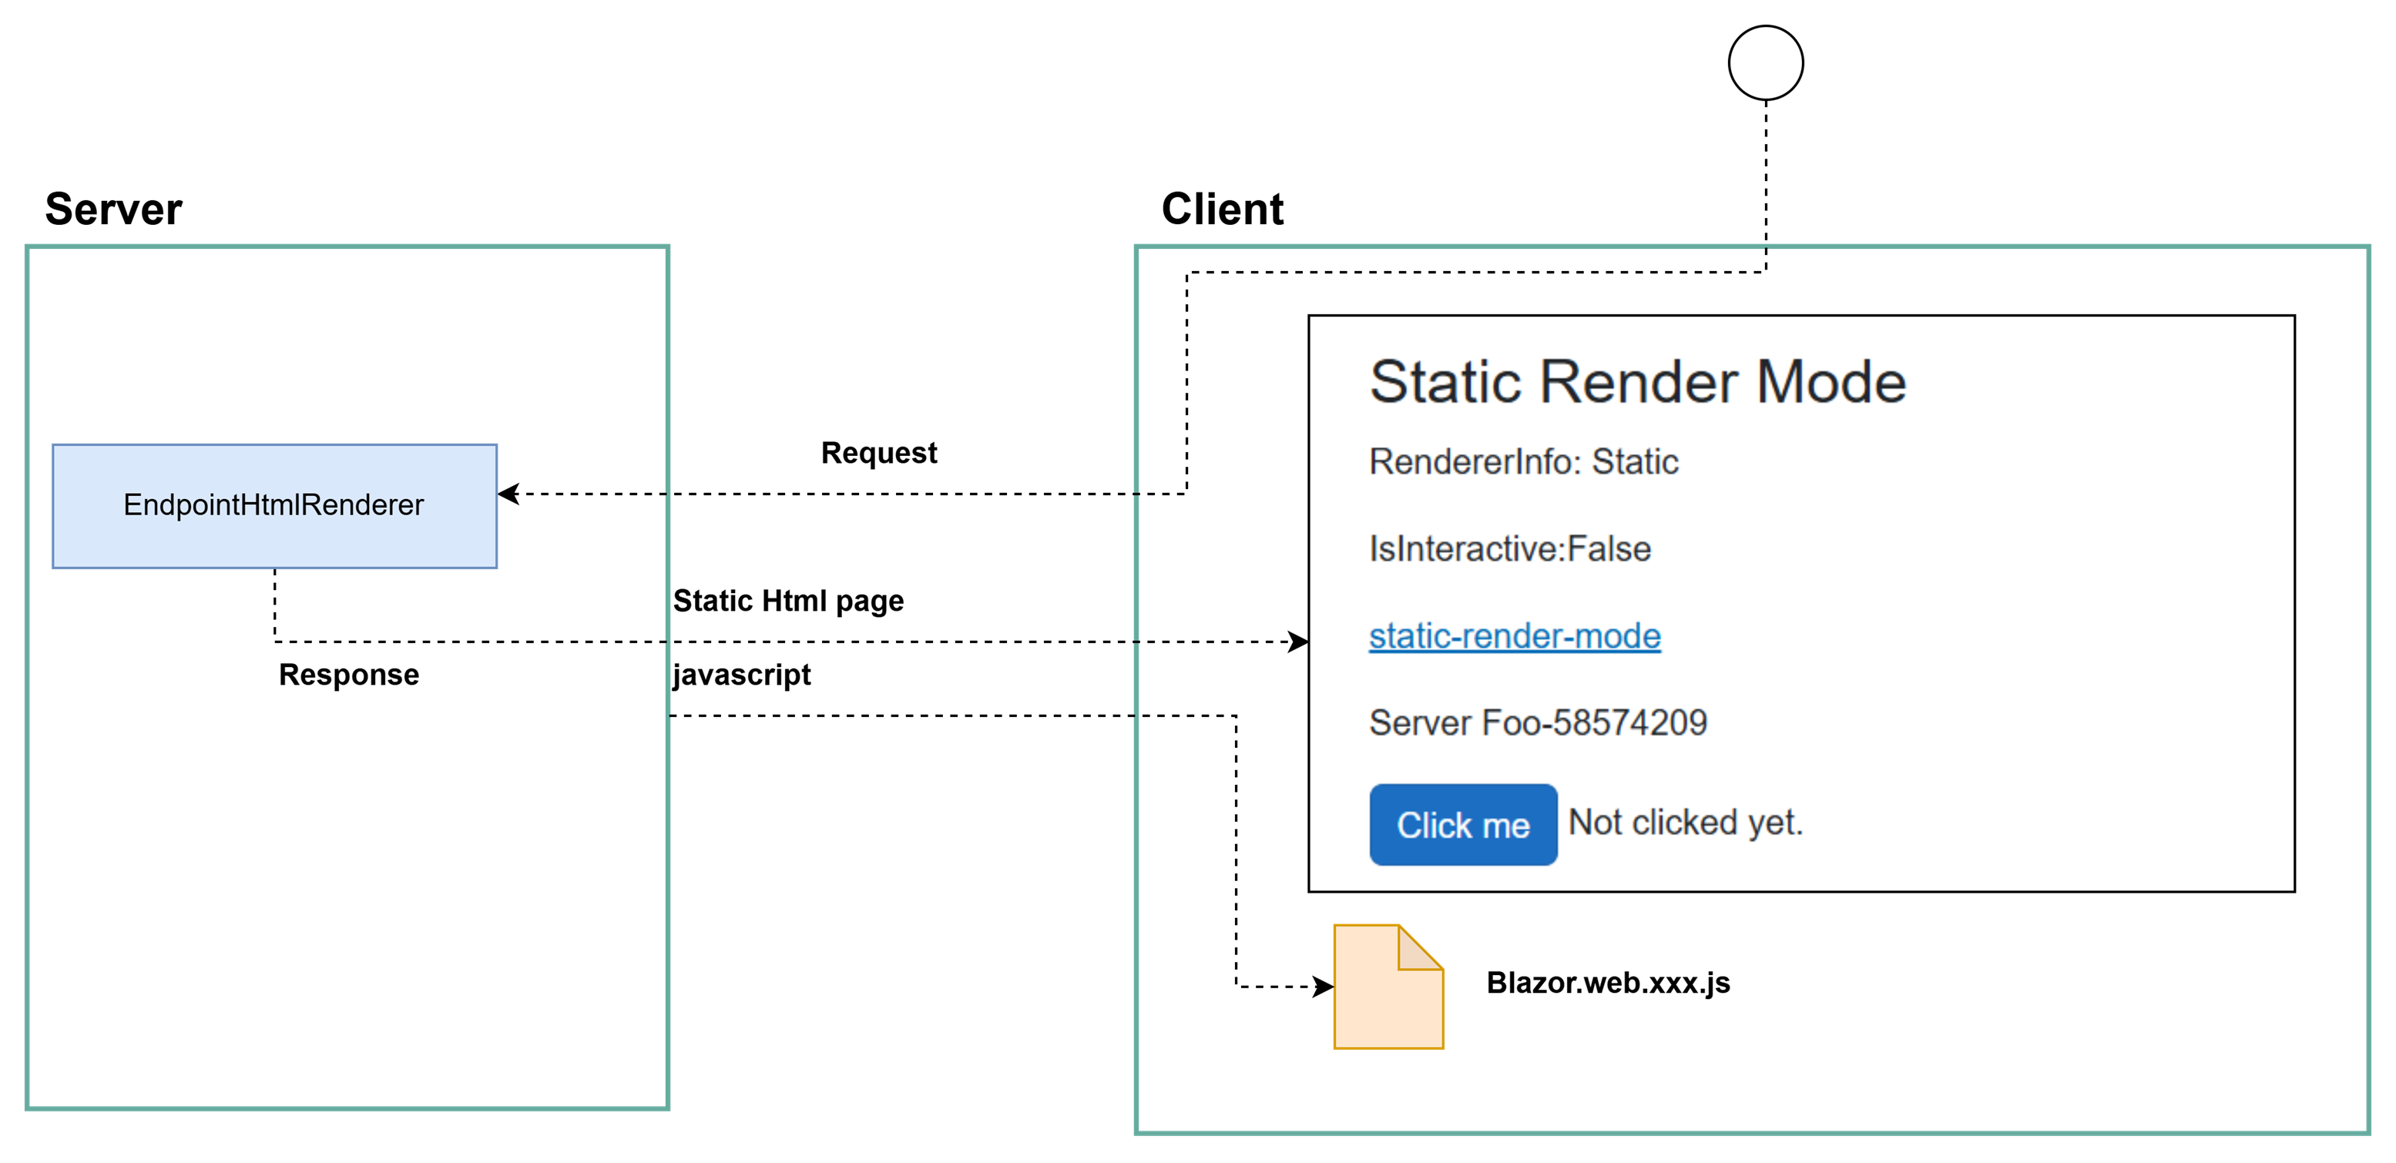

Slide 11
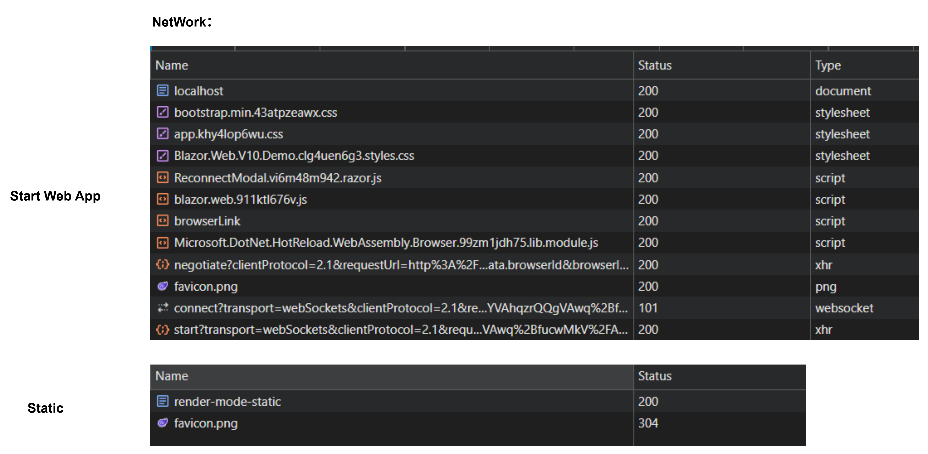

Slide 12
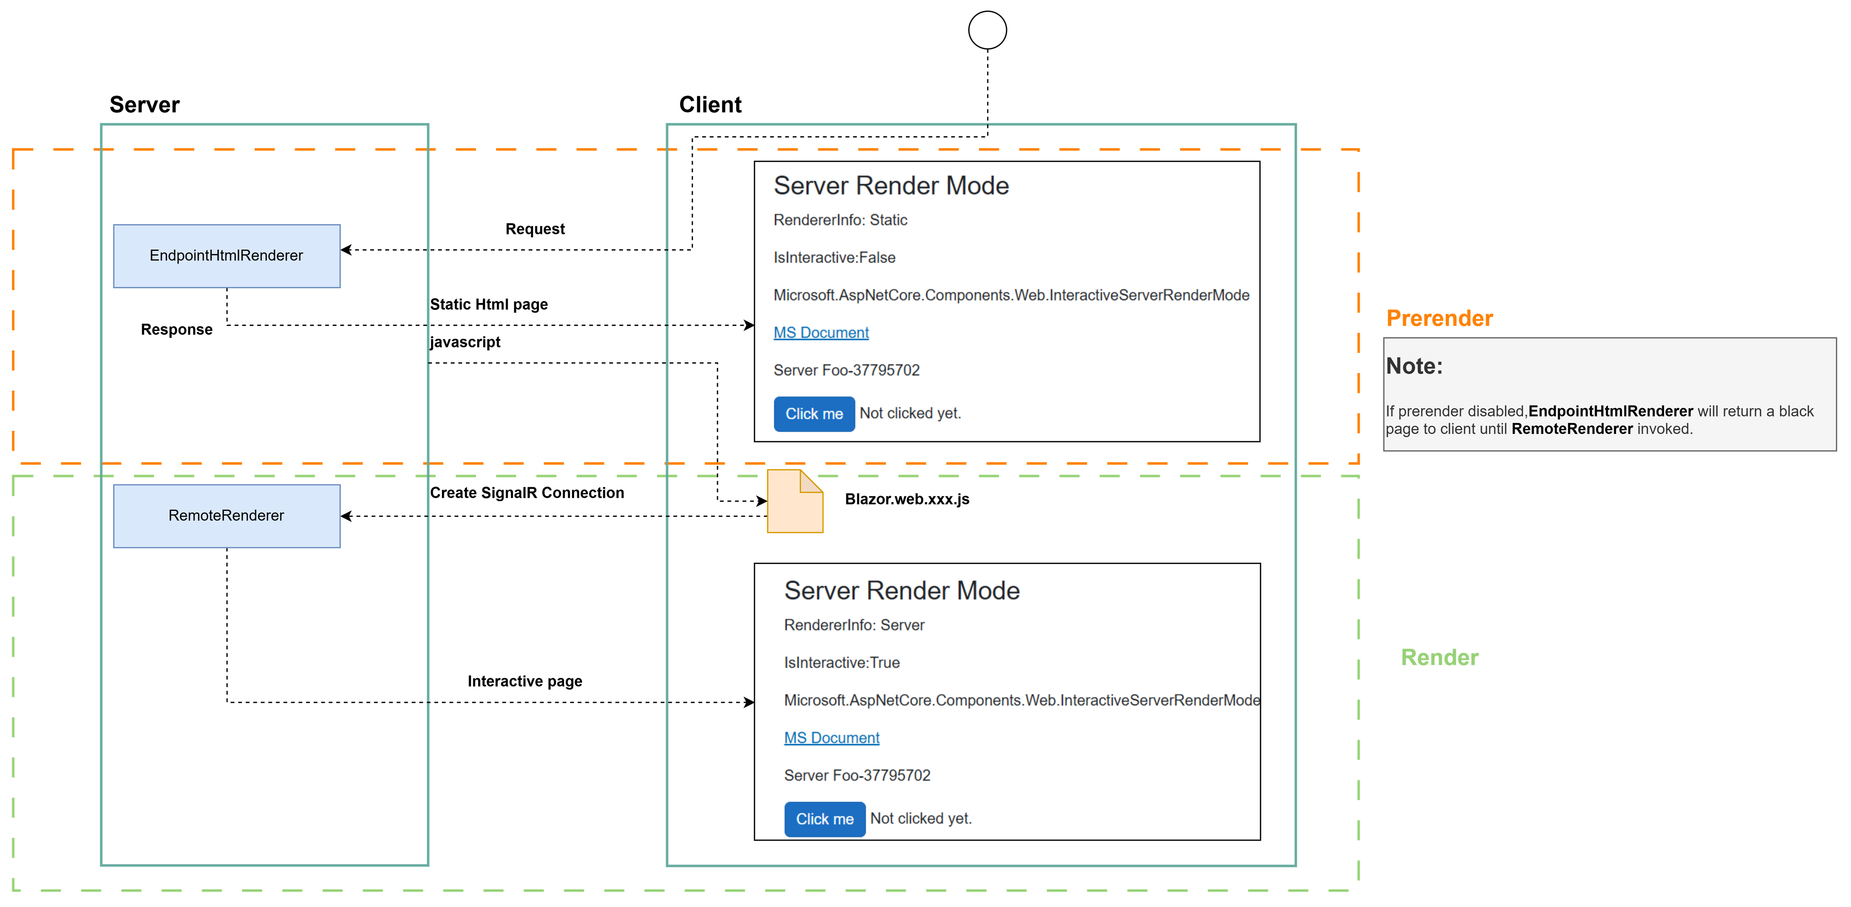

Slide 13
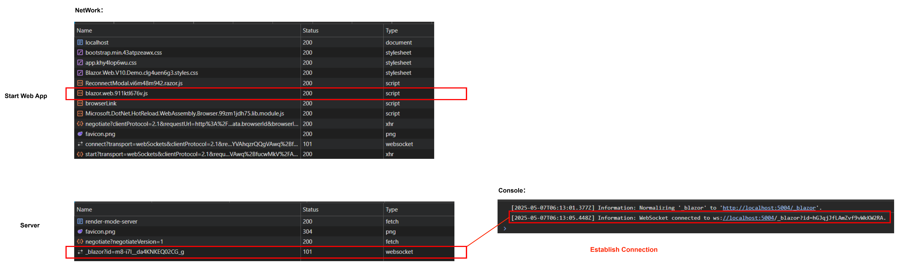

Slide 14
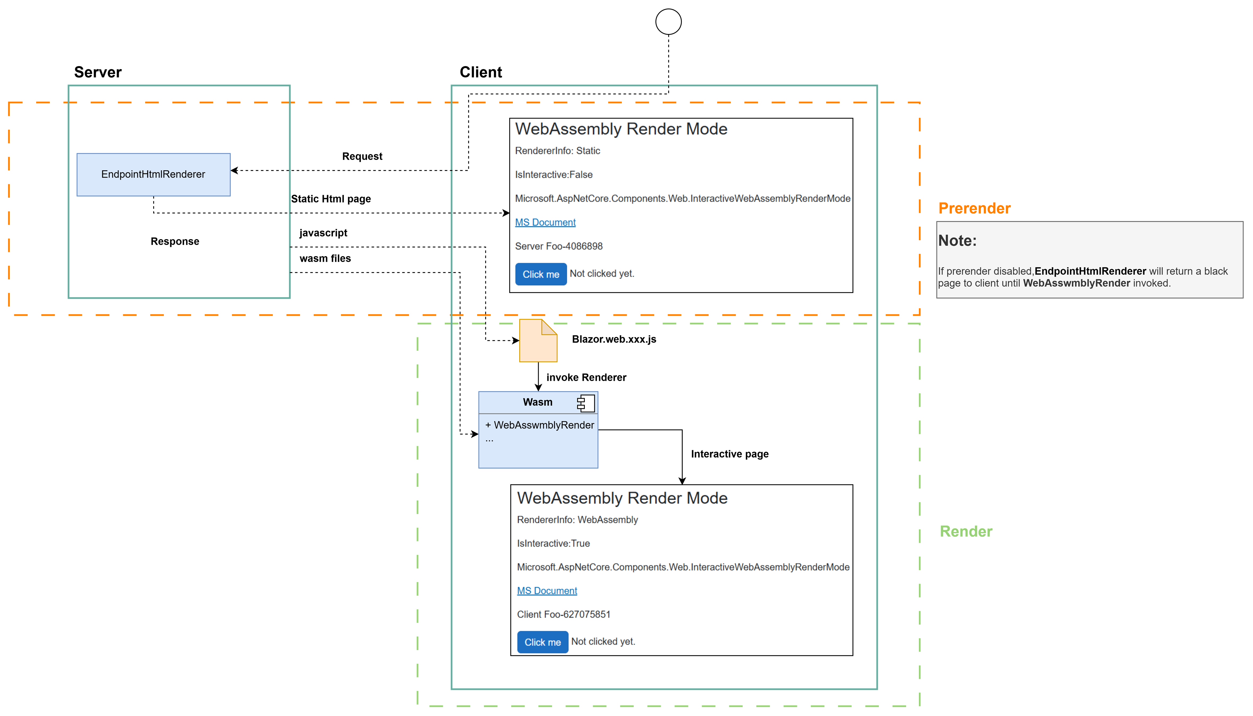

Slide 15
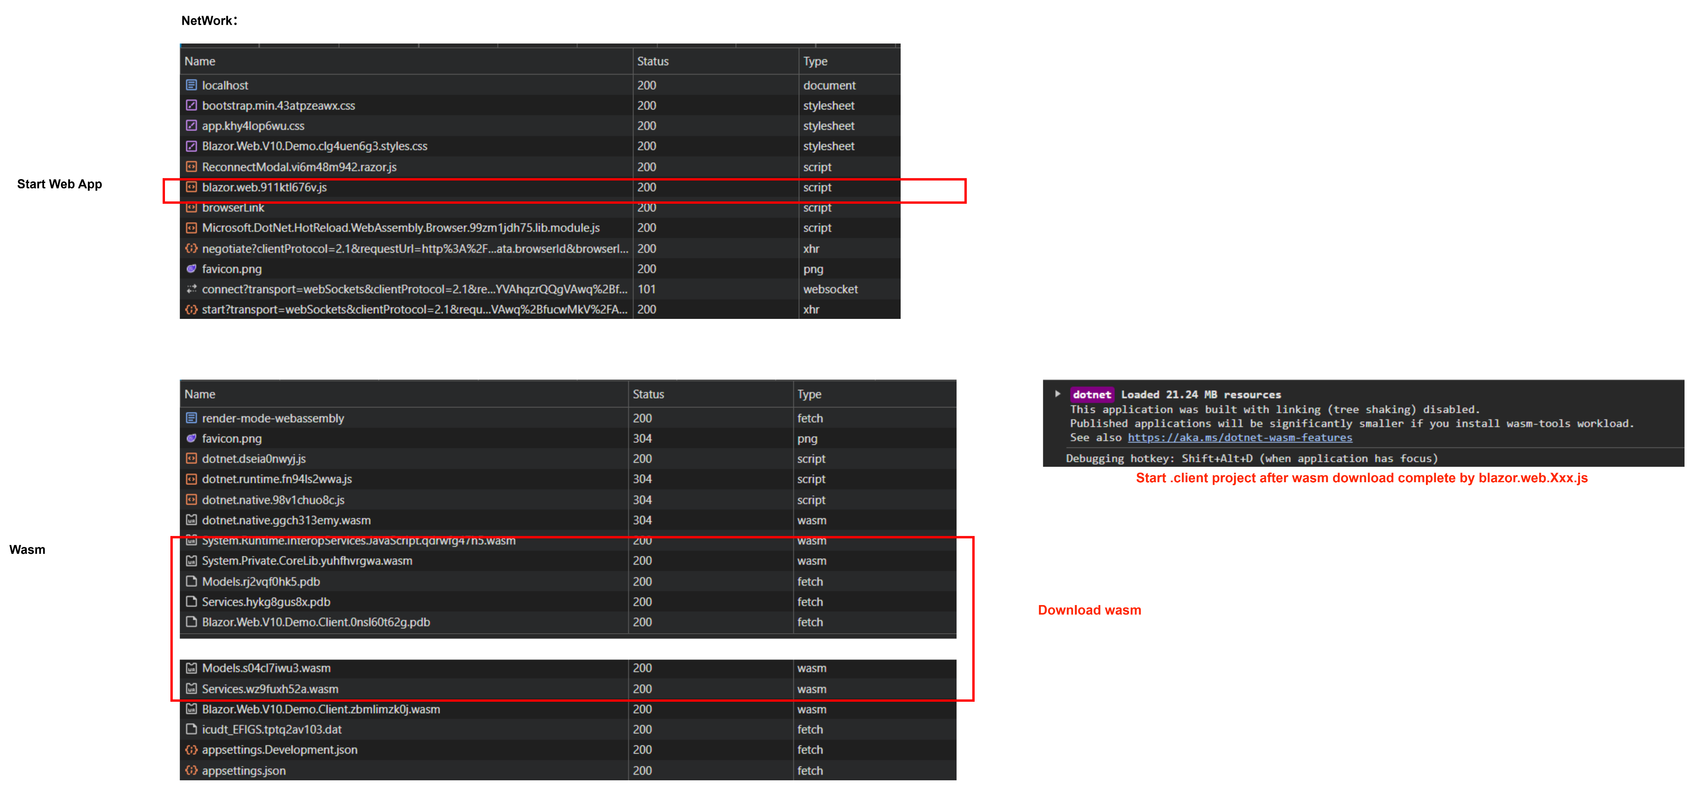

Slide 16
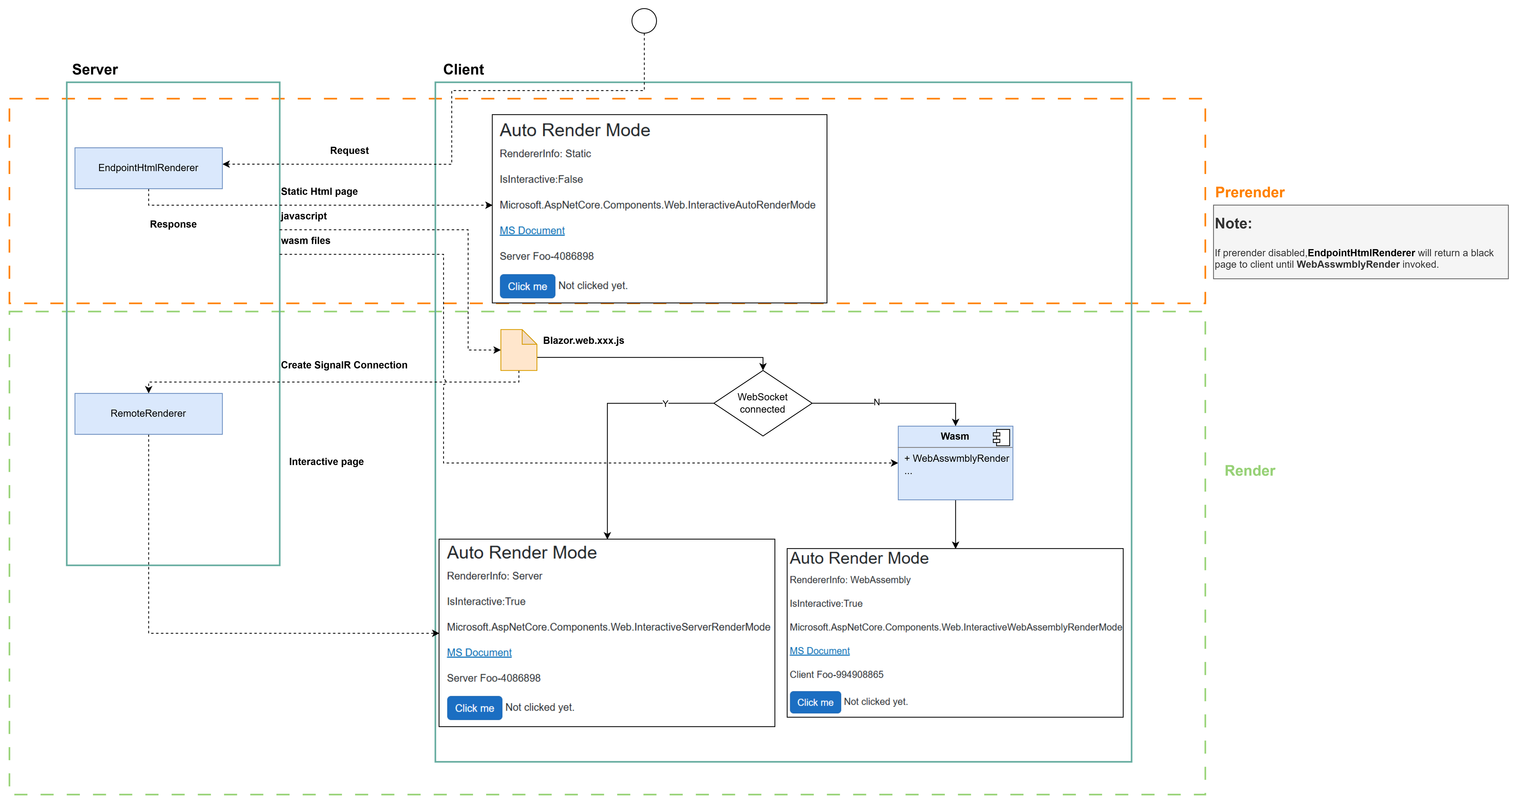

Slide 17
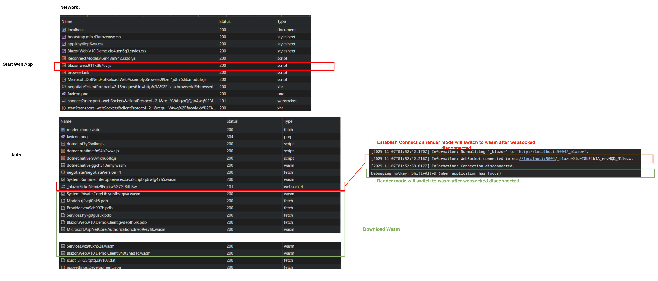

Slide 18
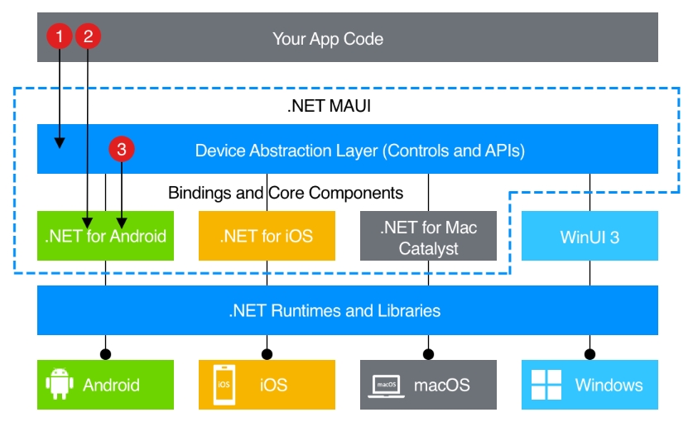
https://learn.microsoft.com/en-us/dotnet/maui/what-is-maui?view=net-maui-10.0

Slide 19
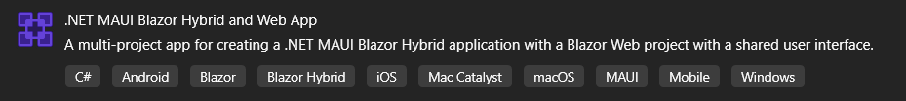
.Net MAUI Blazor hybrid and web app
Introduction
This is a new solution template in ASP .NET 9 makes it easier to create .NET MAUI native and Blazor web client apps that share the same UI.
https://learn.microsoft.com/en-us/aspnet/core/release-notes/aspnetcore-9.0?view=aspnetcore-9.0#net-maui-blazor-hybrid-and-web-app-solution-template

Slide 20
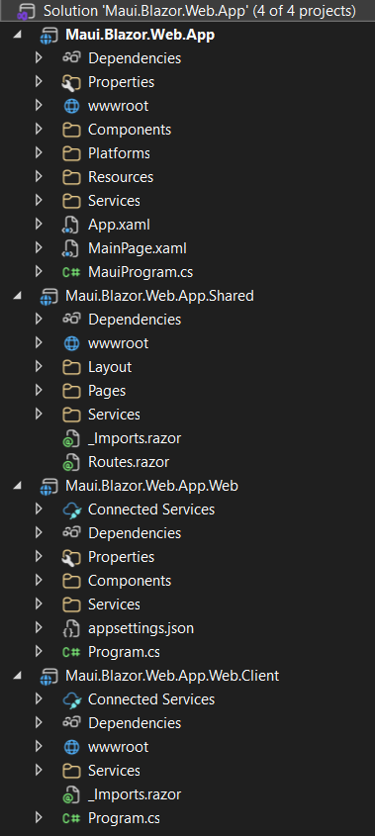
.Net MAUI Blazor hybrid and web app
Introduction
Can start .NET MAUI app at {ProjectName} or Blazor web app at {ProjectName}.Web
Razor pages shared by .NET MAUI app and Blazor web app at {ProjectName}.Shared
Blazor web app browser features at {ProjectName}.Client(Only WebAssembly and Auto interactive render mode have)
Blazor Web
MAUI Blazor hybrid
App.Web
App
App.Shared
App.Web.Client

Slide 21
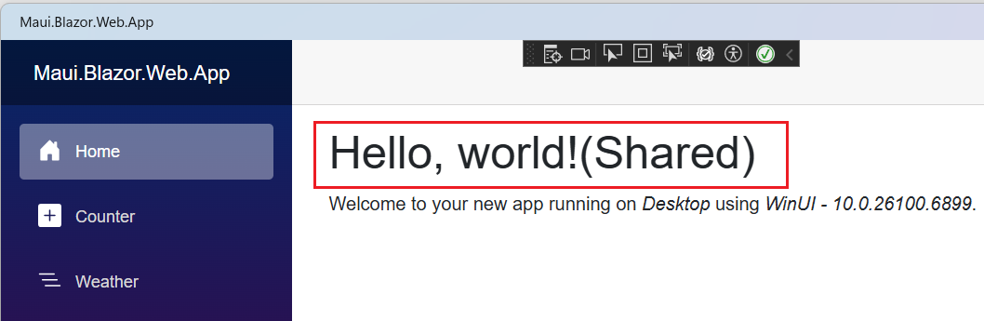
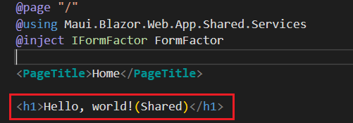
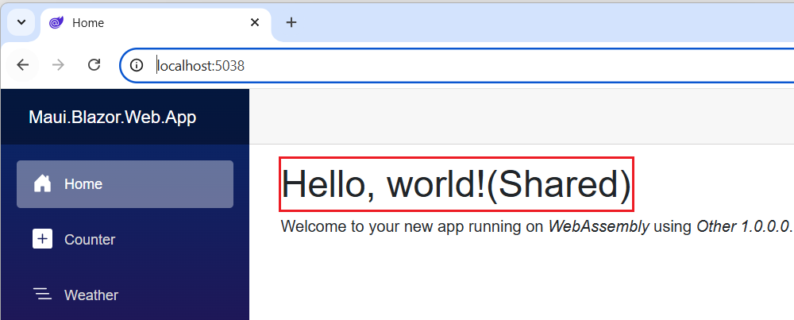
.Net MAUI Blazor hybrid and web app

Slide 22
.Net MAUI Blazor hybrid and web app
Introduction
{ProjectName}.Web Program.cs
{ProjectName} MauiProgram.cs
var builder = WebApplication.CreateBuilder(args);
// Add services to the container.
builder.Services.AddRazorComponents()
.AddInteractiveWebAssemblyComponents();
//...
var app = builder.Build();
//...
app.MapRazorComponents<App>()
.AddInteractiveWebAssemblyRenderMode()
.AddAdditionalAssemblies(
typeof(Maui.Blazor.Web.App.Shared._Imports).Assembly,
typeof(Maui.Blazor.Web.App.Web.Client._Imports).Assembly);
app.Run();
public static class MauiProgram
{
public static MauiApp CreateMauiApp()
{
var builder = MauiApp.CreateBuilder();
builder
.UseMauiApp<App>()
.ConfigureFonts(fonts =>
{
fonts.AddFont("OpenSans-Regular.ttf", "OpenSansRegular");
});
//...
builder.Services.AddMauiBlazorWebView();
return builder.Build();
}
}

Slide 23
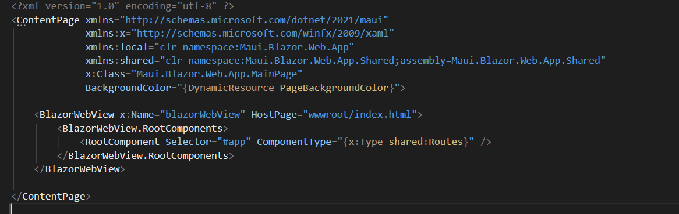
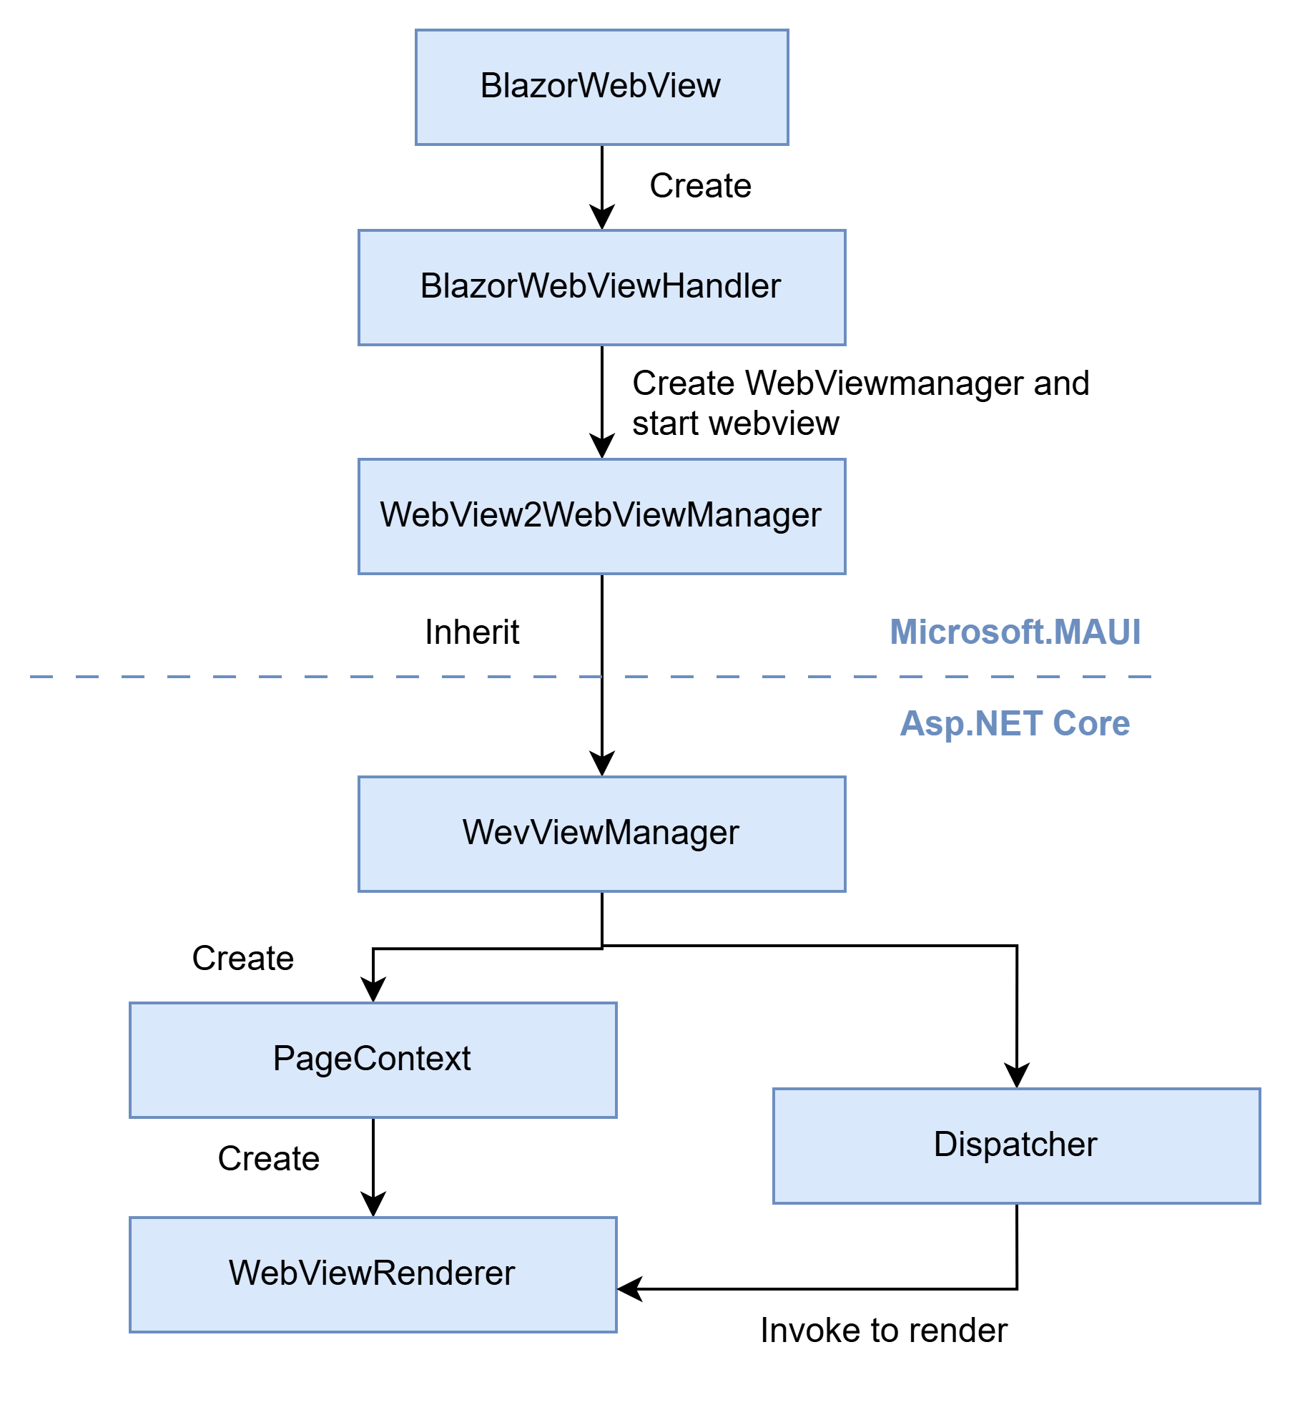

Slide 24
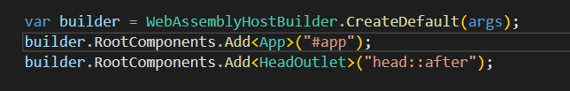
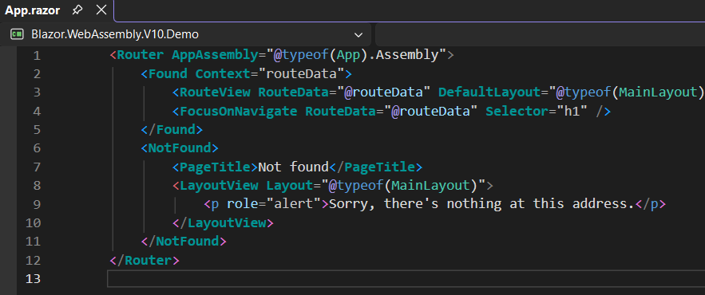
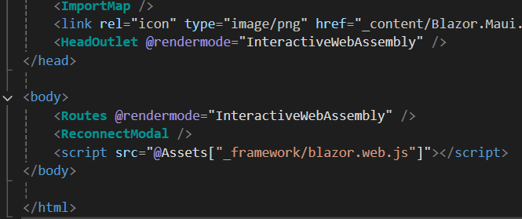
.Net MAUI Blazor hybrid and web app
Blazor WebAssembly Standalone App config in Program.cs
The configuration equal to what Blazor WebAssembly Standalone App config in Program.cs and App.razor
Blazor WebAssembly Standalone App config in App.razor
MAUI Blazor hybrid and web app config in App.Razor

Slide 25
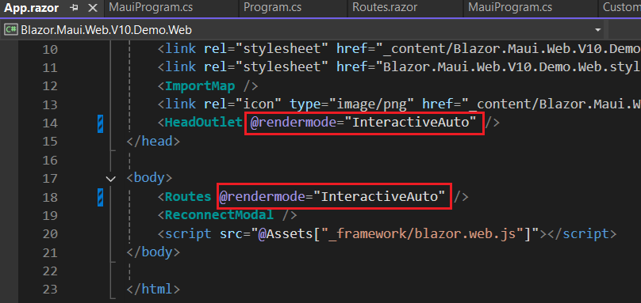
.Net MAUI Blazor hybrid and web app
Different with Blazor web app, MAUI Blazor hybrid and web app config root componment render mode explicitly in App.razor‌ to make web app keep one render mode.
MAUI Blazor hybrid and web app config in App.Razor

Slide 26
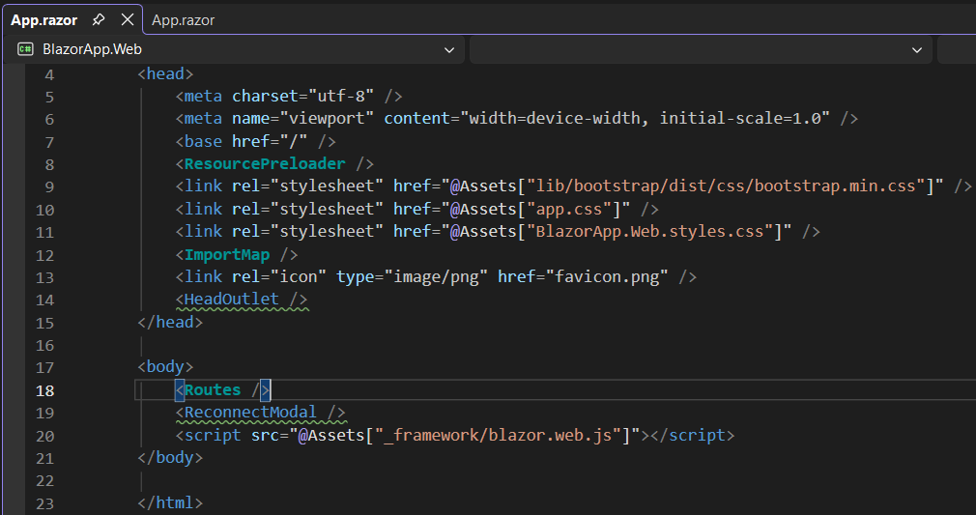
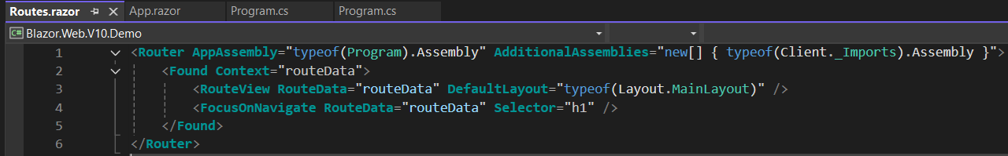
.Net MAUI Blazor hybrid and web app
Blazor Web App

Slide 27
.Net MAUI Blazor hybrid and web app
Thinking about StarterkitOnWeb
If want to develop blazor as desktop app and keep web app also, MAUI Blazor hybrid and web app is the best choice to keep both and make UI code reuse better.
Current structure
Default created structure
After refactor
Web
|--Admin.BlazorWeb
|--Admin.NGWeb
|--CMS.MvcWeb
Web
|--Admin.MauiBlazorHybrid.Client
|--Admin.MauiBlazorHybrid.Web
|--Admin.MauiBlazorHybrid
|--Admin.MauiBlazorHybrid.Shared
|--CMS.MvcWeb
|--Admin.NGWeb
UI(or other name)
|--Web
|--CMS.MvcWeb
|--Admin.NGWeb
|--MauiBlazorHybrid
|--Admin.MauiBlazorHybrid.Client
|--Admin.MauiBlazorHybrid.Web
|--Admin.MauiBlazorHybrid
|--Admin.MauiBlazorHybrid.Shared

Slide 28
Because of Services has already registed before app running(DbContext,HttpClient e.g). Need to config and start up App by Shell or restart App.
Config and startup app
Config and restart app
MAUI Shell
MAUI App
MAUI App
MAUI App
Config File
Config File

